Slide 1
Augmentation-Free Self-Supervised Learning on Graphs
Namkyeong Lee, Junseok Lee, Chanyoung Park
AAAI 2022, #citation = 24
Speaker: Zheng-Ming Lin
2023-01-06

Slide 2
Outline
Introduction
Related work
Problem
Solution
Experiment
Conclusion

Slide 3
Introduction
Why self-supervised learning
Pretraining on a larger (unlabeled) dataset
Finetuning on a smaller (labeled) dataset
Graph representation
Graph-level representation
Node-level representation

Slide 4
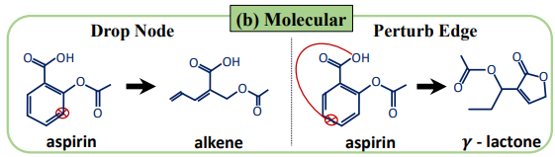
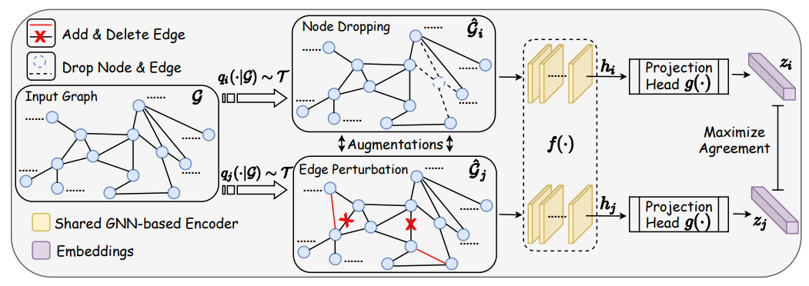
Related Work
Graph Contrastive Learning with Augmentations
Cons: different type of dataset should have its augmentations

Slide 5
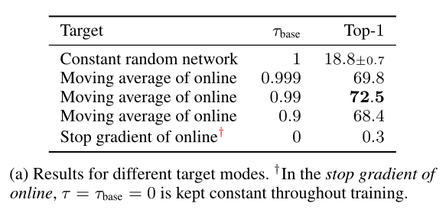
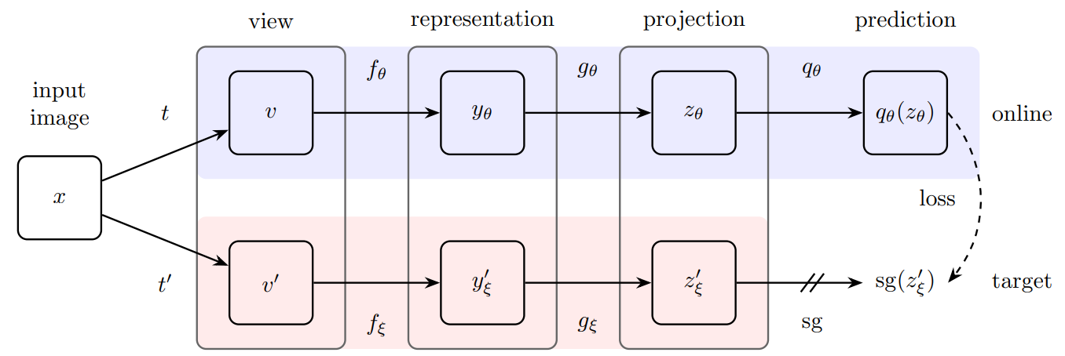
Related Work
Bootstrap Your Own Latent
Don’t leverage negative sample
ξ ← τ ξ + (1 − τ )θ

Slide 6
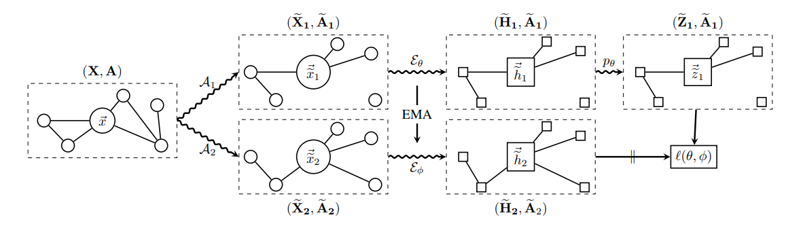
Related Work
BGRL: Bootstrapped Representation Learning on Graphs
Cons: the quality of the learned node representations relies on the choice of the augmentation scheme

Slide 7
Problem
Graph Contrastive Learning with Augmentations
Cons: different type of dataset should have its augmentations
BGRL: Bootstrapped Representation Learning on Graphs
Cons: the quality of the learned node representations relies on the choice of the augmentation scheme
How to select augmentation scheme?
Augmentation free, self-supervised learning, graph

Slide 8
Problem Definition
Notations
G = (V, E)
X: feature matrix
A: adjacency matrix
Task: unsupervised graph representation learning
Given a graph G along with X and A
Aim to learn a encoder f(·) that produces node embedding H = f(X, A) that generalize well to various downstream tasks

Slide 9
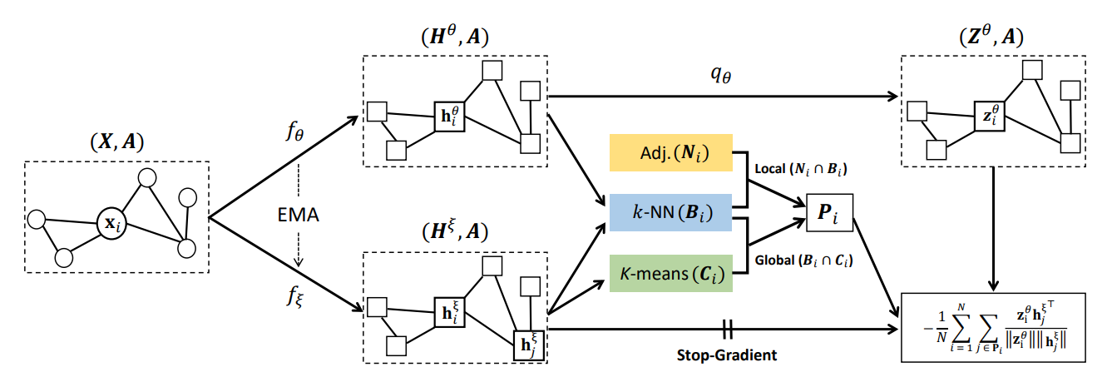
Framework of Augmentation-Free Graph Representation Learning
encoder: GCN

Slide 10
AFGRL vs BGRL
AFGRL
BGRL

Slide 11
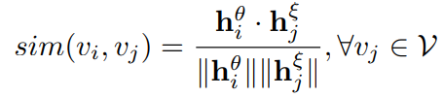
Local Structural Information
Local positives
Compute the cosine similarity as the distance
Use k-NN search positive samples and denote B_{i}
B_{i} contains samples that are not semantically related to the query node v_{i}

Slide 12
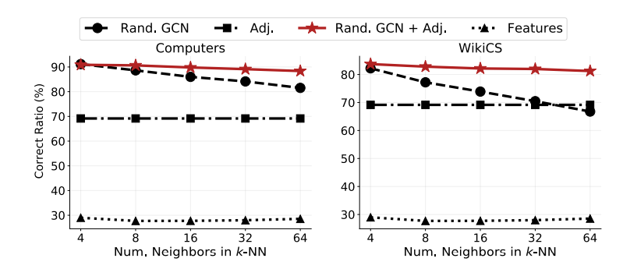
Local Structural Information
Local positives
To filter out false positives from the nearest neighbors found by k-NN search
Leverage the local structural information among nodes
Local positives: B_{i} ∩ N_{i}
Rand. GCN: obtain node embeddings from a randomly initialized 2-layer GCN

Slide 13
Global Semantic
Global positives
Use K-means search positive samples and denote C_{i}
Semantically similar entities that do not share an edge can be discovered via clustering in a global perspective

Slide 14
Global Semantic
Global positives
K-means clustering algorithm is sensitive to the cluster centroid initialization, perform K-means clustering M times for robustness
Global positives: B_{i} ∩ C_{i}

Slide 15
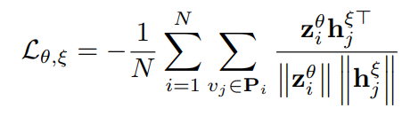
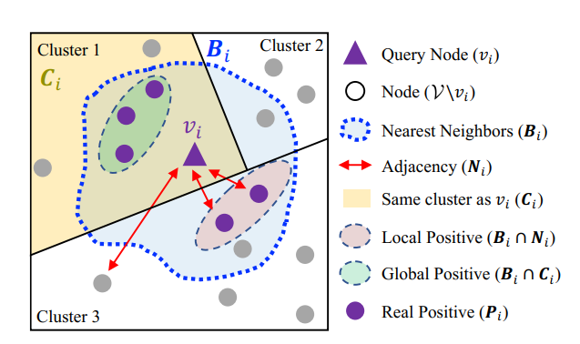
Overall
Objective Function
Real positives: (B_{i} ∩ N_{i}) ∪ (B_{i} ∩ C_{i}) = B_{i} ∩ (N_{i} ∪ C_{i})
Minimize the cosine distance between the query node and its real positives

Slide 16
Dataset
WikiCs: the dataset is constructed from Wikipedia categories
Amazon: E-commerce network
Coauthor: a human-AI collaborative writing dataset

Slide 17
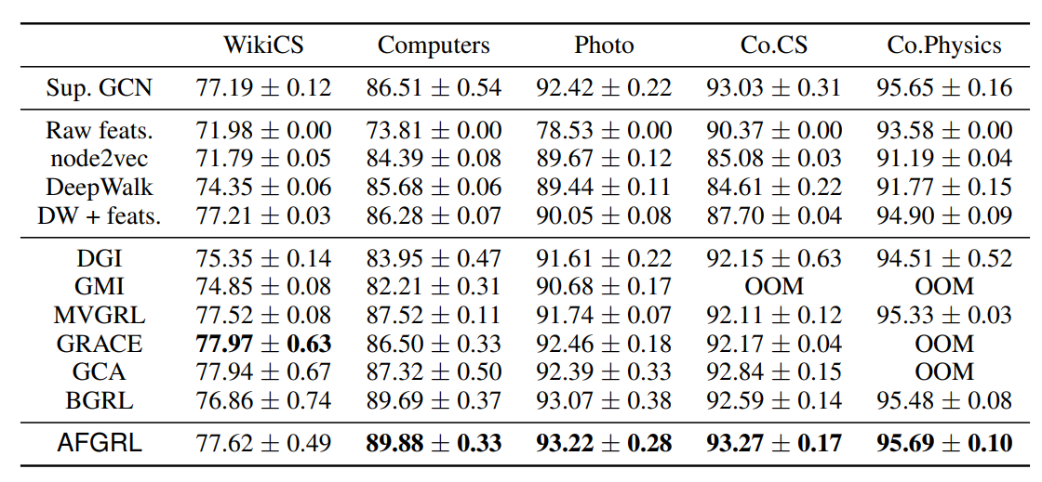
Experiment - node classification
Their performance is highly sensitive to the choice of augmentation hyperparameters

Slide 18
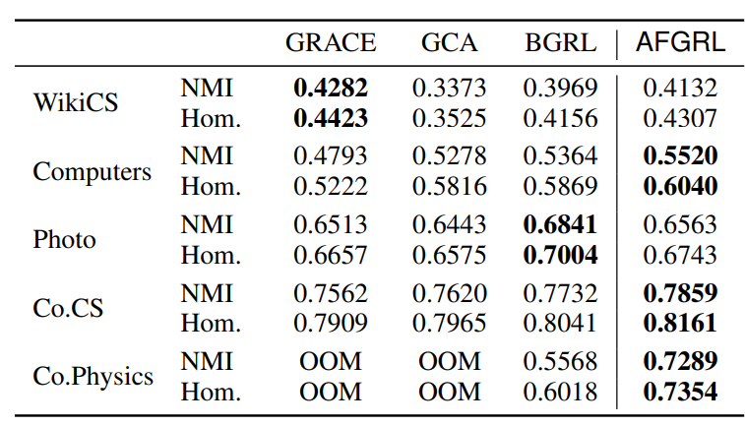
Experiment - node clustering
NMI: measure the mutual information entropy between the resulting cluster labels and ground truth labels followed by a normalization operation
AFGRL also considers global semantic information

Slide 19
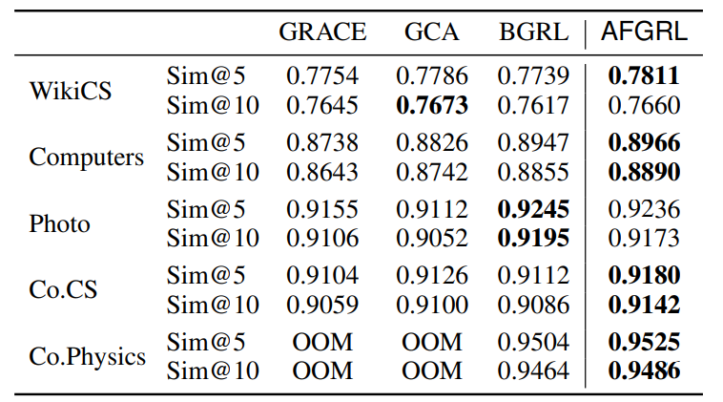
Experiment - similarity search
Sim@n: Average ratio among n nearest neighbors sharing the same label as the query node
This is expected because AFGRL aims to make nearest neighbors of each node share the same label with the query node by discovering the local and the global positives

Slide 20
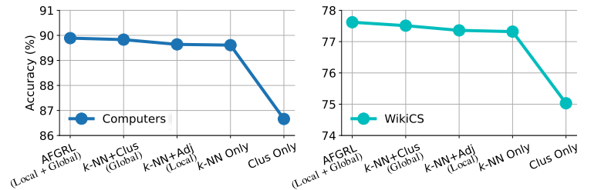
Ablation Study
Clus Only: implies the importance of considering the local structural information in graph-structured data

Slide 21
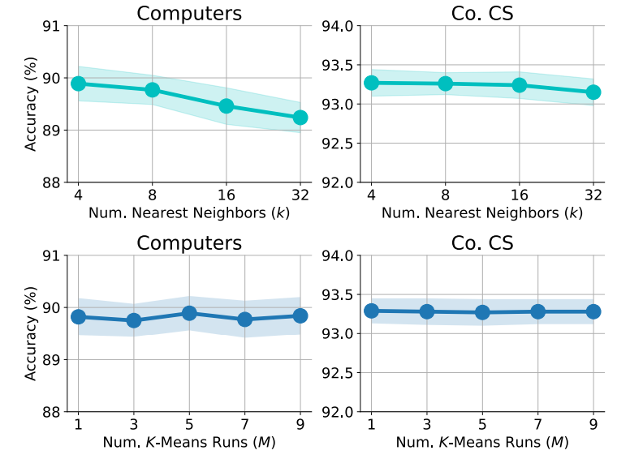
Ablation Study - #Nearest Neighbors and #K-Means Runs

Slide 22
Conclusion
Problems
The quality of the learned node representations relies on the choice of the augmentation scheme
Solution
Without data augmentation, use the original graph to do k-NN and K-means to explore local and global semantics
Experiment
AFGRL performs better than other method

Slide 23
Conclusion
Pros
Don’t leverage negative sample
Compare with GraphCL, AFGRL doesn’t need to consider the type of dataset for data augmentation
Without data augmentation, AFGRL can still outperform than other method with data augmentation
Cons
Use the same architecture of BGRL without data augmentation
The performance without global semantic is still great

